Slide 1

Demo ETC & MaaS (TOMP-API)
April 2020

Slide 2

Content
Introduction
European Travellers Club
Demo – Assumptions
Demo

Slide 3
Introduction
ACCEPT Institute contracted by Dutch Ministry of Transport and Water management
Demo has the following goals:
  Use a router infrastructure and a uniform transaction format (MaaS Datastring in a MaaS Message) for communication between MaaS Service Providers and Transport Operators;
  Demo needs to be international and cross-border; and
  Integrate (current version of) the TOMP-API.
Demo presented to Cross-border MaaS Pilot Limburg stakeholders:
  Province of Limburg
  Zuid-Limburg Bereikbaar
  Arriva
  Aachener Verkerhsverbund

Slide 4
European Travellers Club (ETC)
ETC Architecture, interoperabele router infrastructure
ETC Business Roles

Slide 5
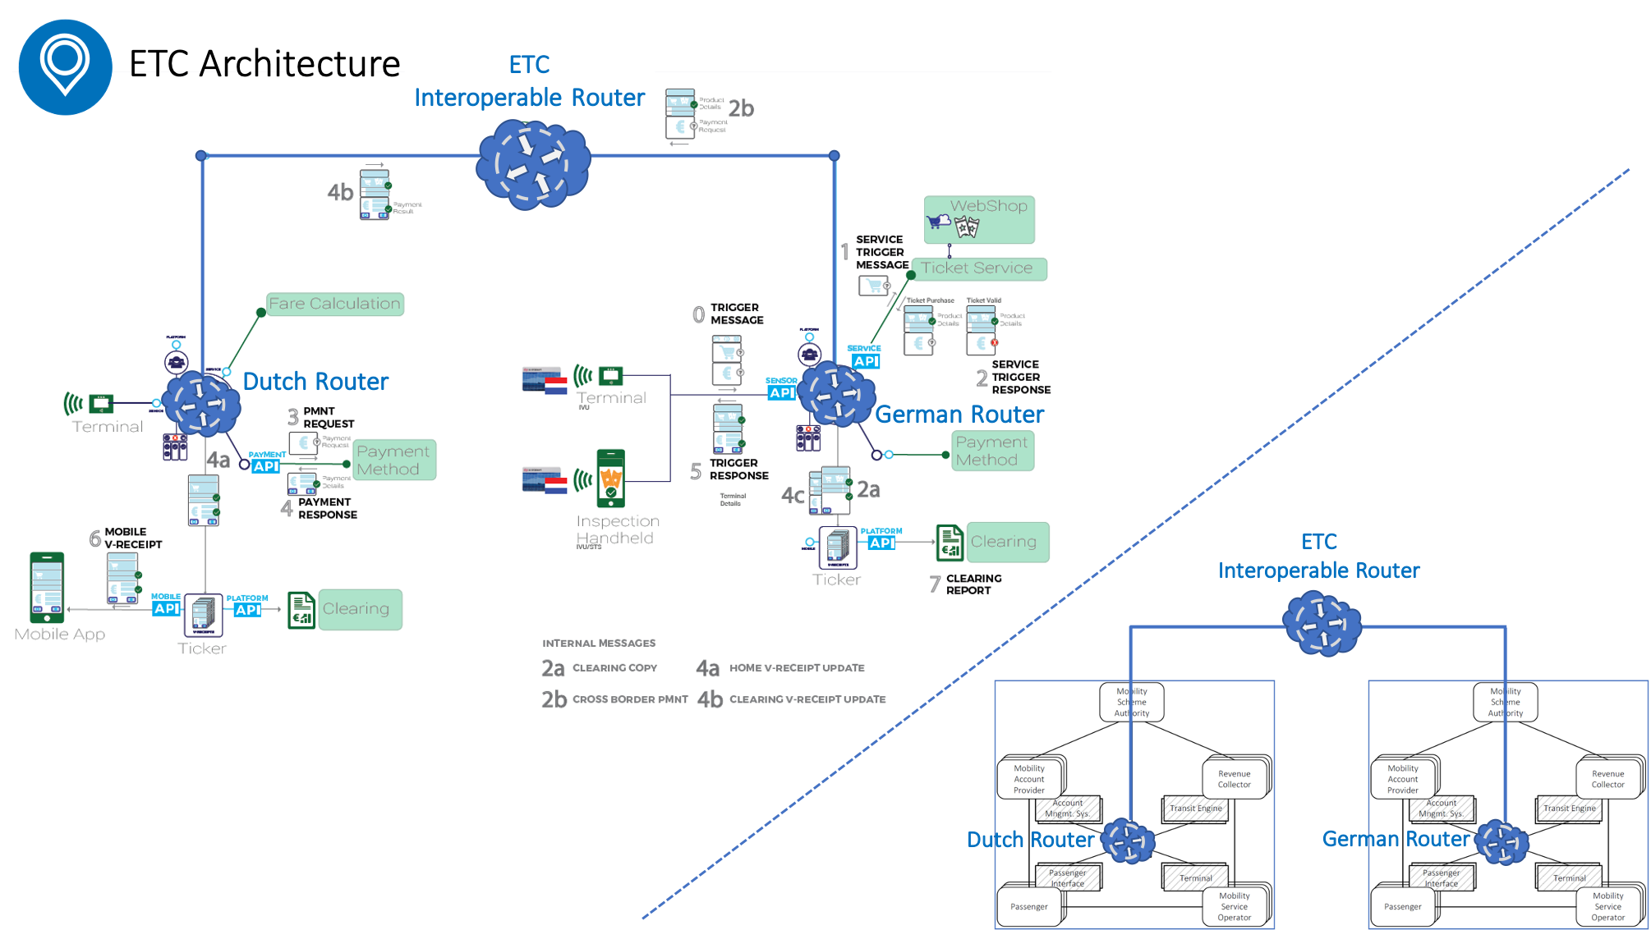
ETC Architecture and Usage of Router set up
ETC Router set up
Funded by European subsidy (Horizon 2020 program)
ACCEPT Institute (not-for-profit) will make available to all:
  open specifications for the router infrastructure
  open source for the API’s
  router infrastructure and API’s at cost
Currently in use by:
  Learning Environment Dutch MaaS Pilots (Ministry of Infrastructure and Environment) → slide 5; and
  Verkéiersverbond (Luxembourg Transport Authority) for Park & Ride solution → slide 6.
Planned useage:
  Aachener Verkehrsverbund (AVV) for German EasyConnect project.

Slide 6
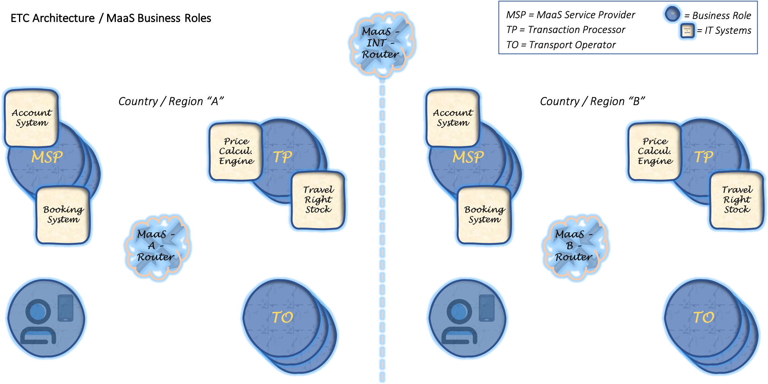

Slide 7
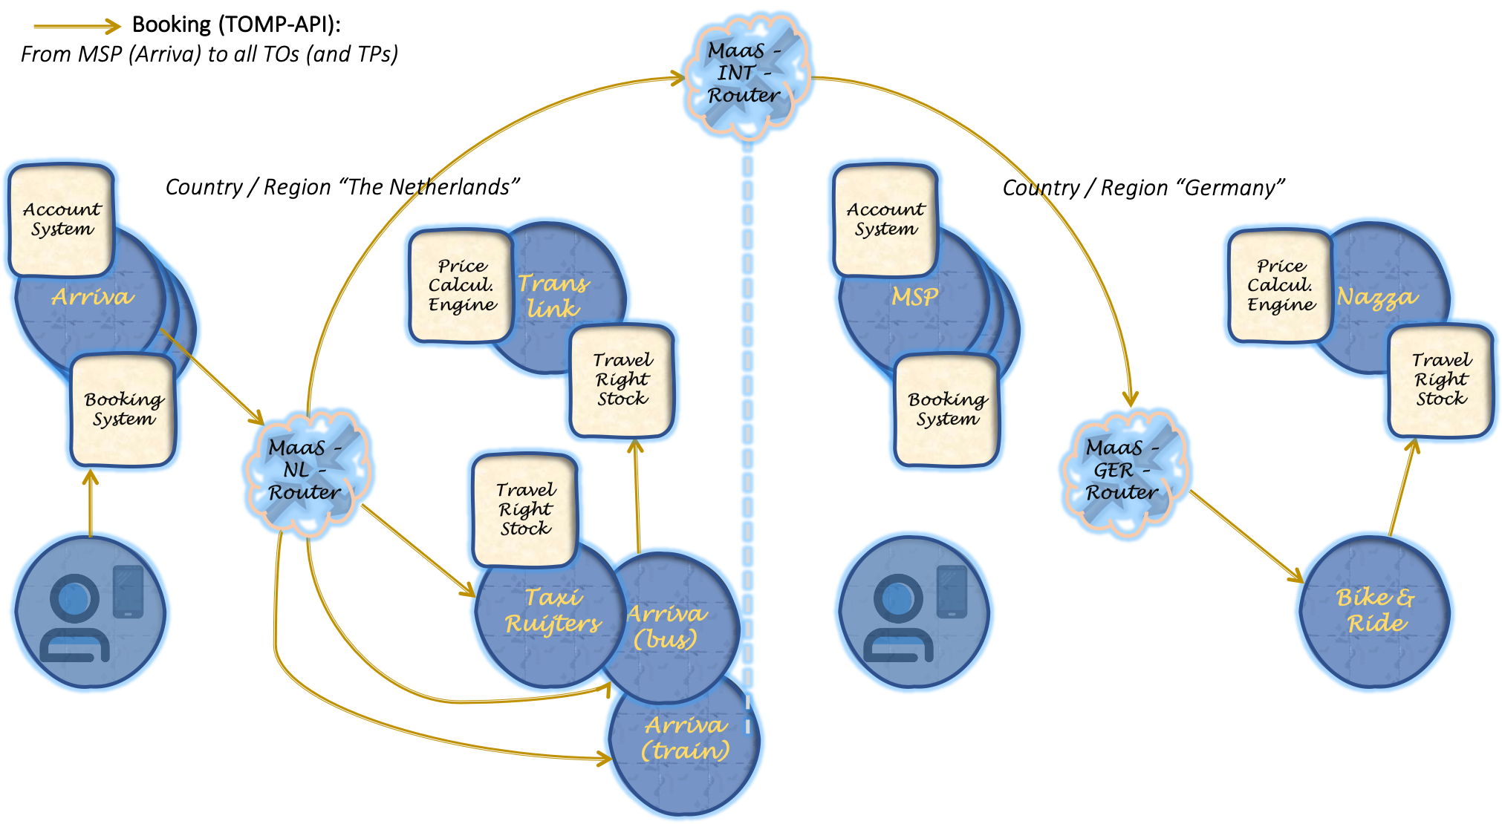

Slide 8
Demo - Assumptions

Slide 9
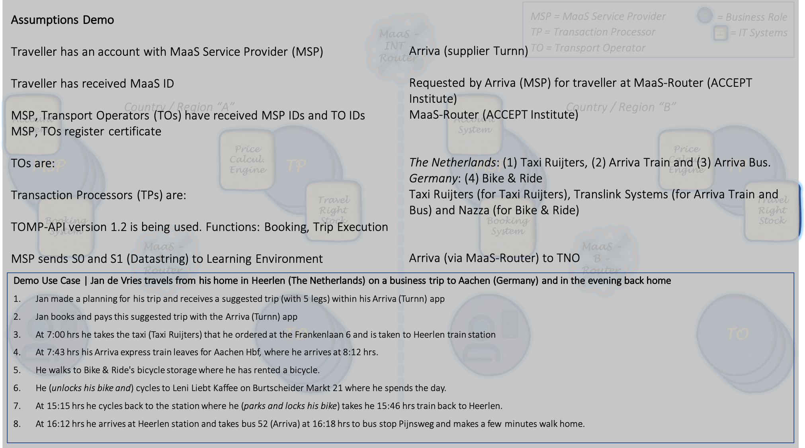

Slide 10
Demo

Slide 11
Demo contents
Part 1: Introduction and booking phase of the demo
Part 2: Receival and processing of bookings at Transport Operators and Travel Right Stocks
Part 3: The trip execution and conclusion of the demo, including a full overview of all messages sent

Slide 12
Demo Part 1: Introduction and booking phase of the demo

Slide 13
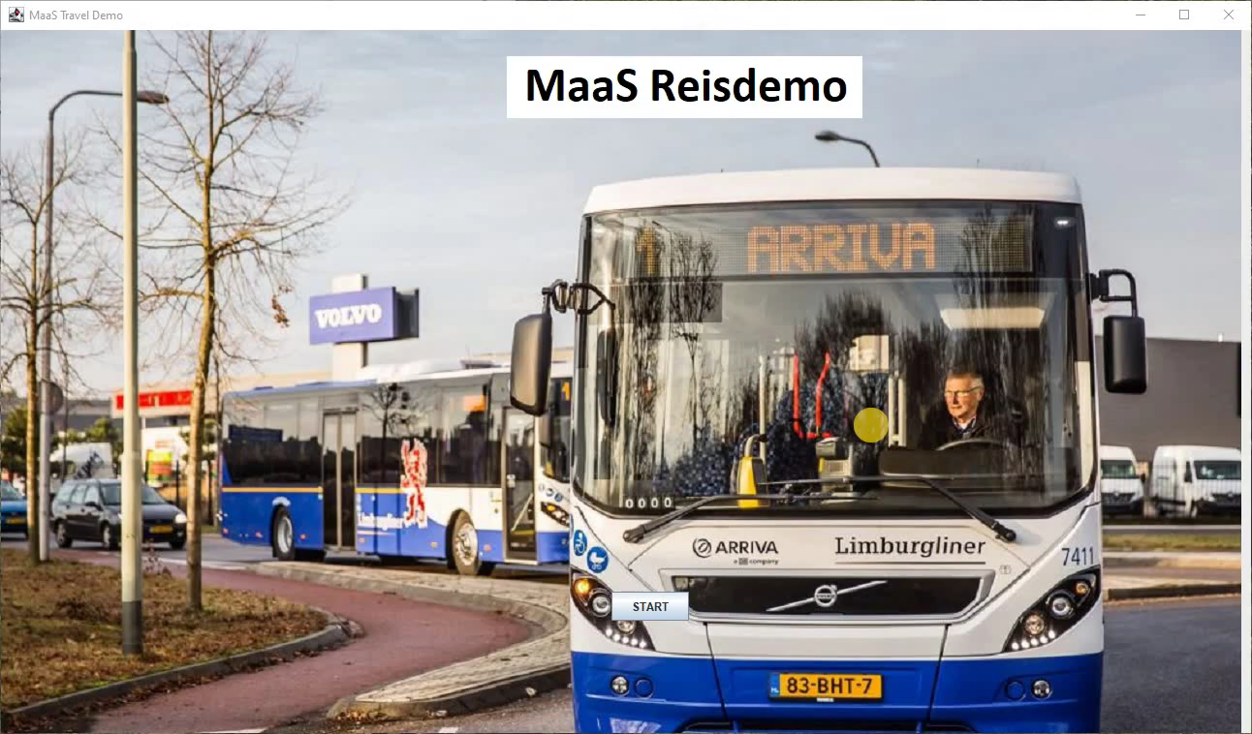

Slide 14
Demo Part 2: Receival and processing of bookings at Transport Operators and Travel Right Stocks

Slide 15
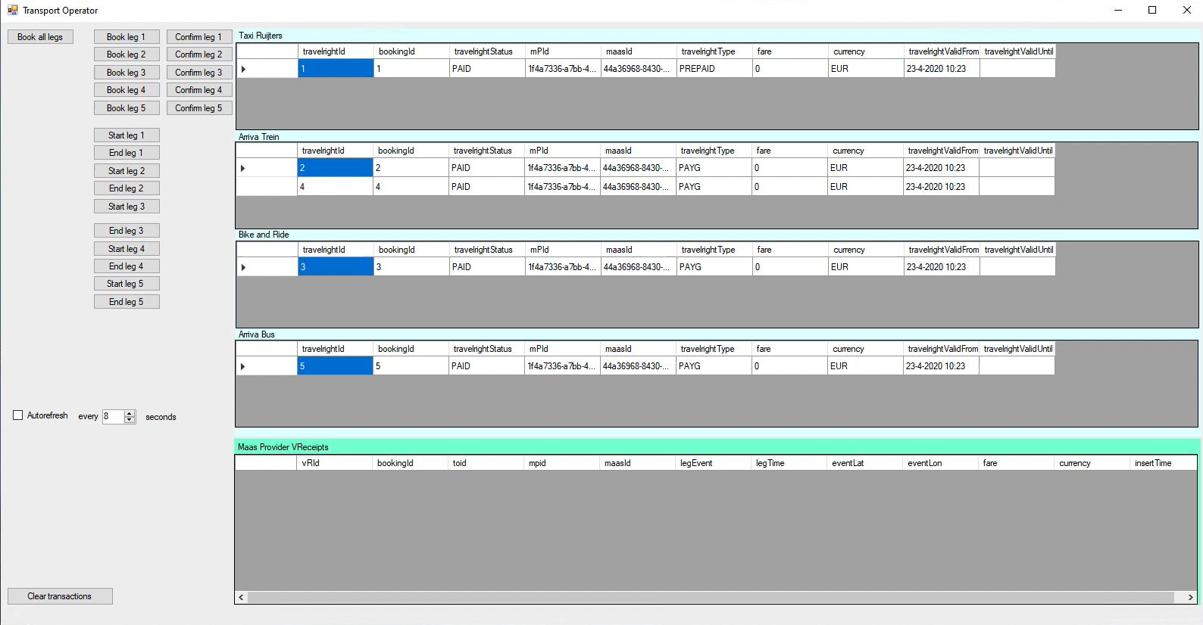

Slide 16
Demo Part 3: The trip execution and conclusion of the demo, including a full overview of all messages sent

Slide 17
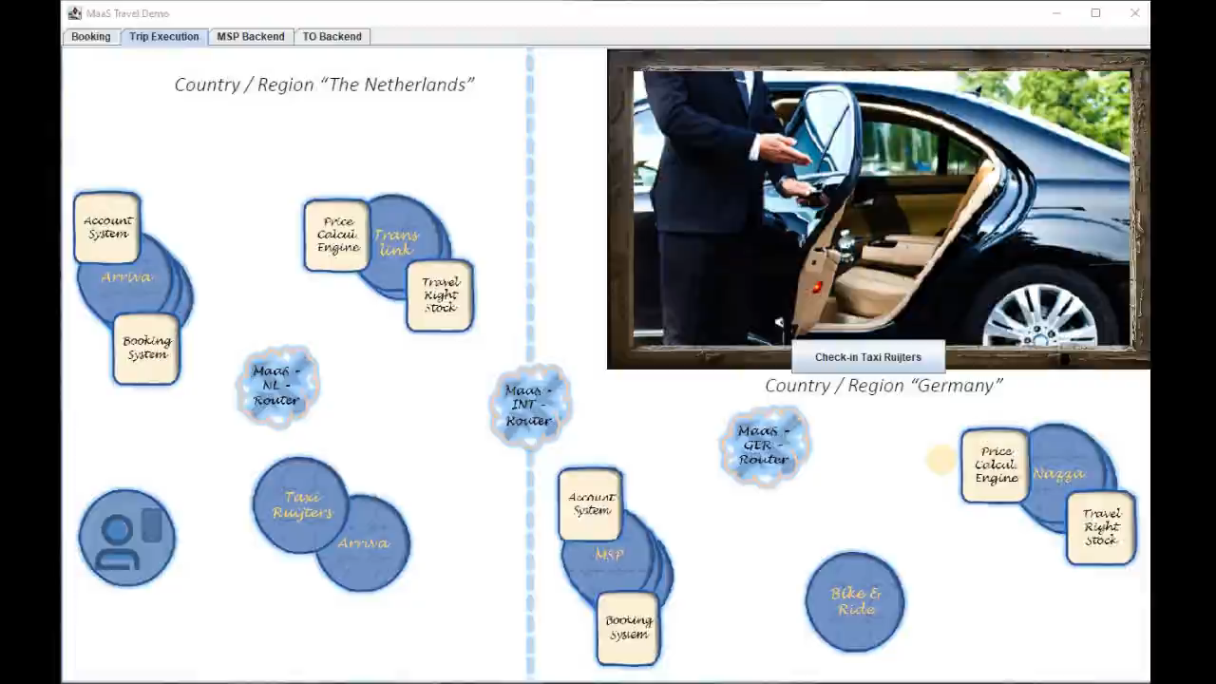

Slide 18
For any questions or inquiries,
please contact us at info@acceptinstitute.eu

